Slide 1
Meeting 12
Tuesday 24/04/2018

Slide 2
Agenda
BEACon – SCADA data
Stability
Comparison of results

Slide 3
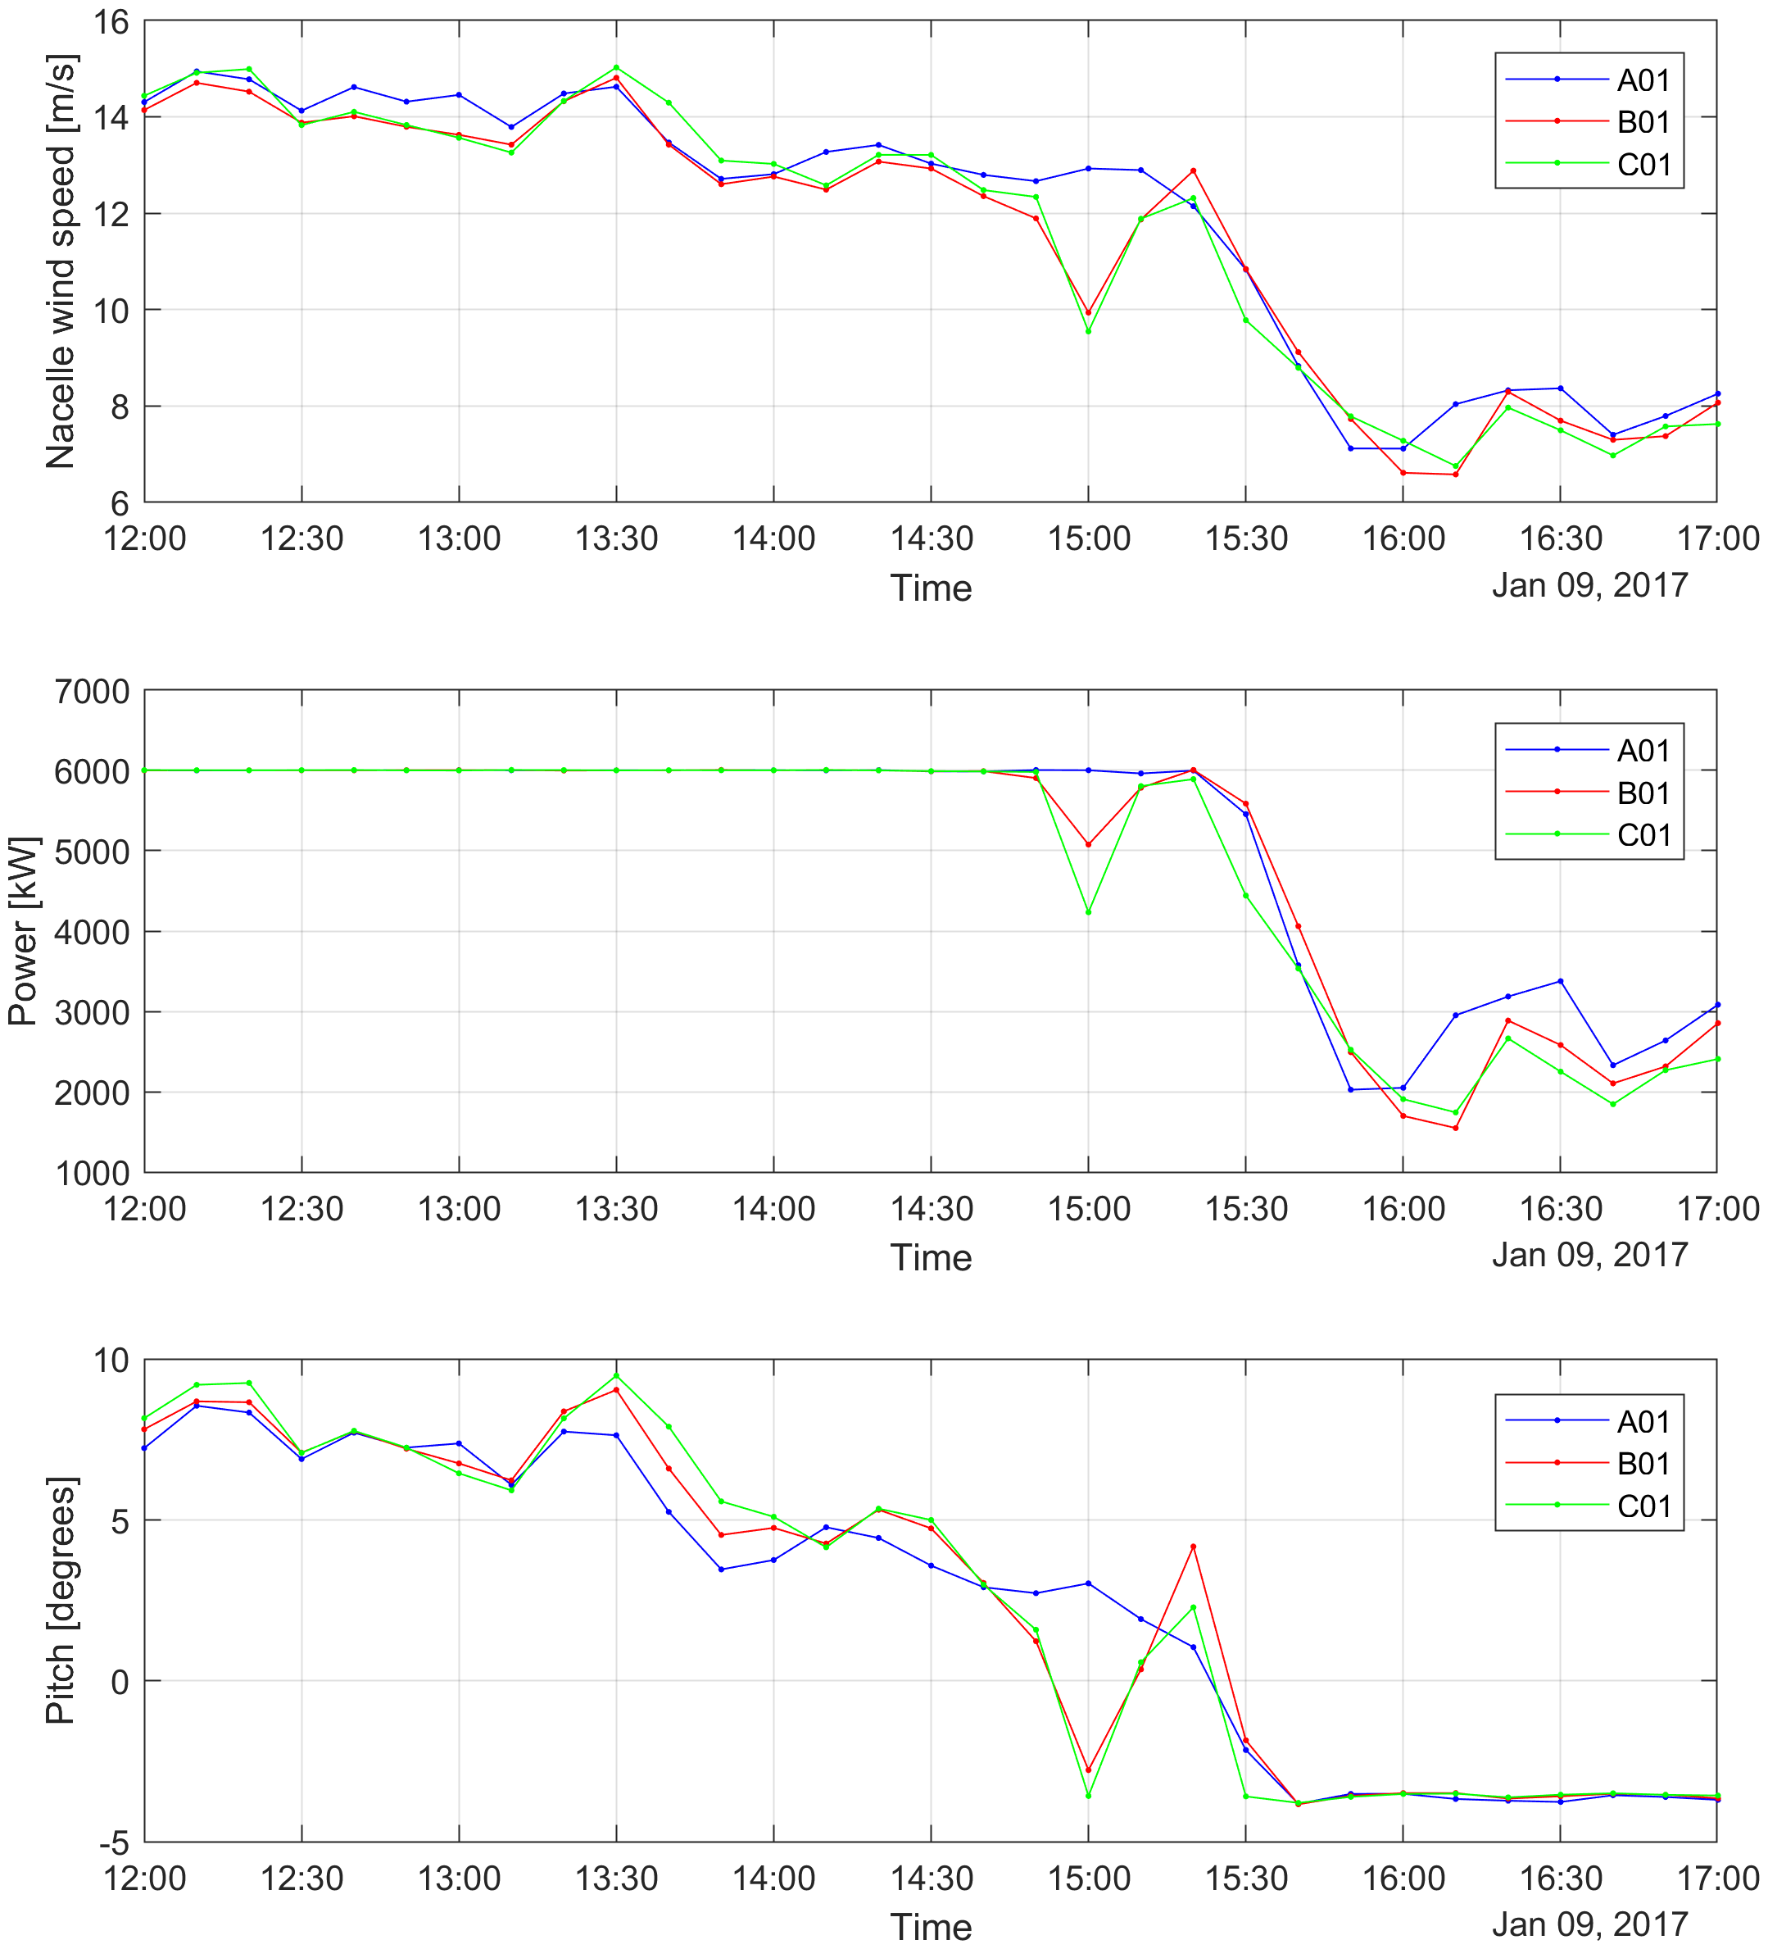
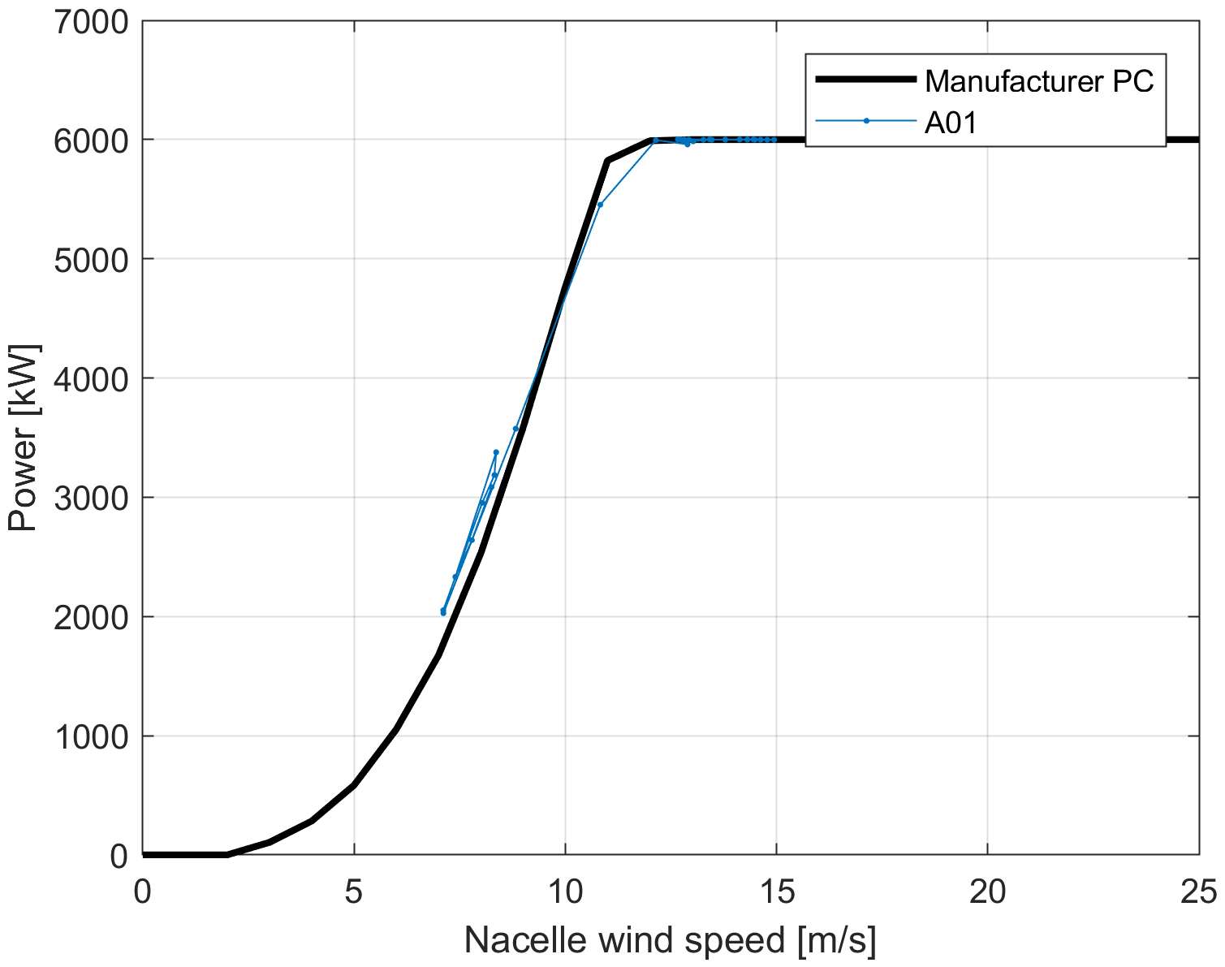
BEACon - SCADA data
Case 1: U0=12 m/s

Slide 4
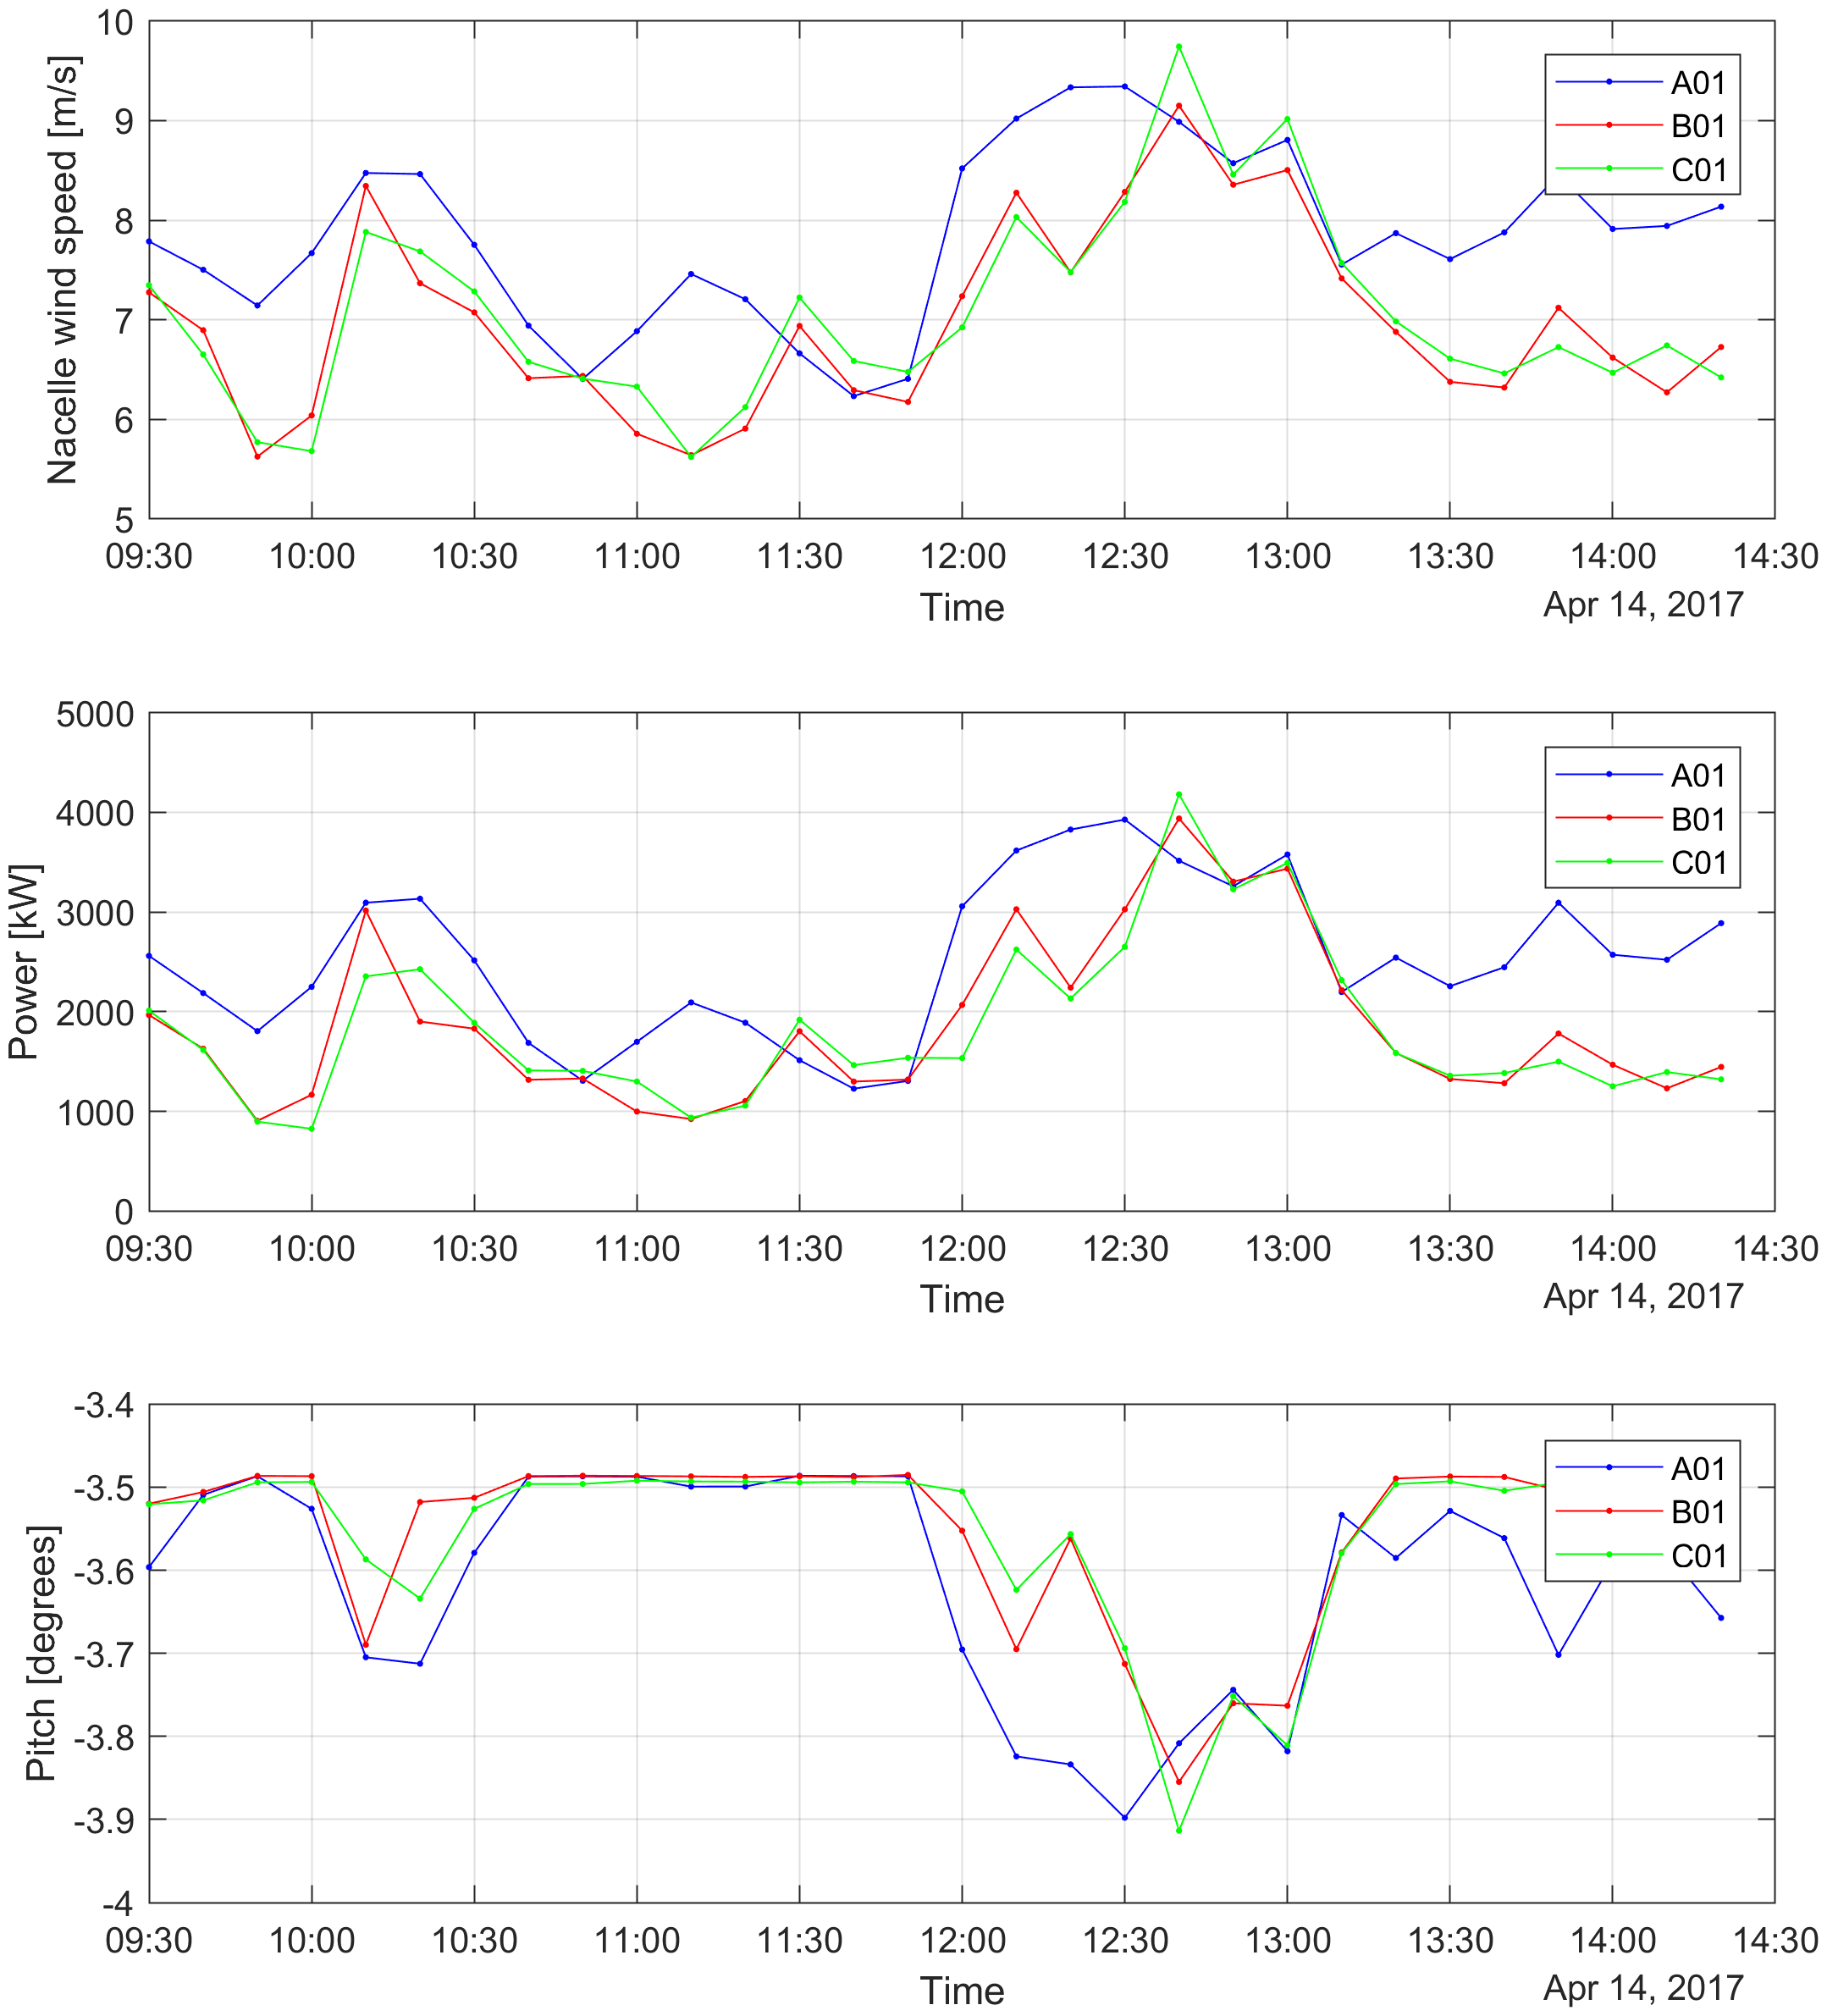
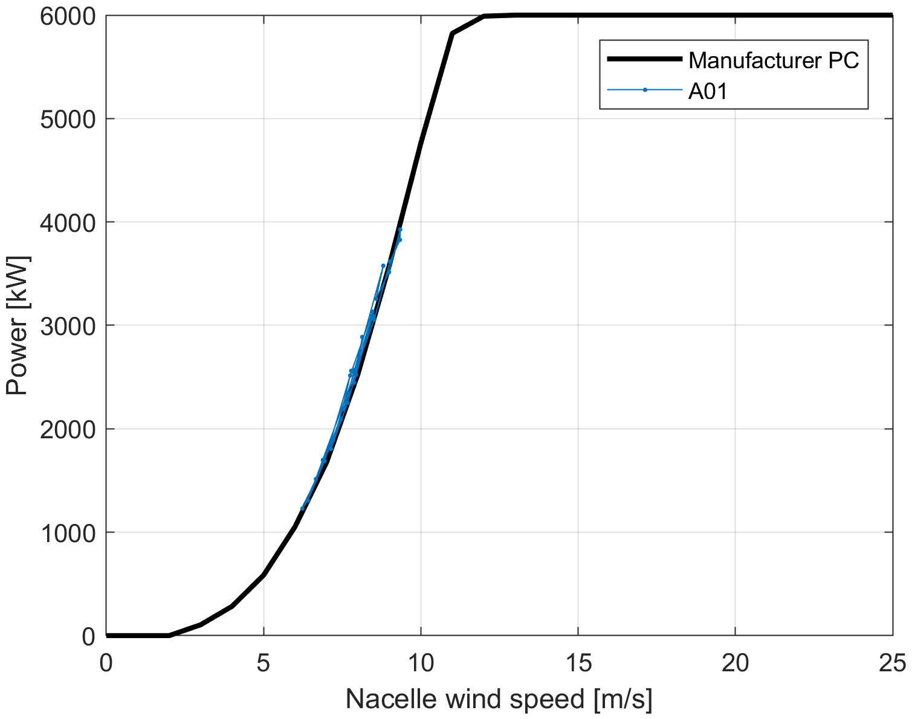
BEACon - SCADA data
Case 2: U0=9 m/s

Slide 5
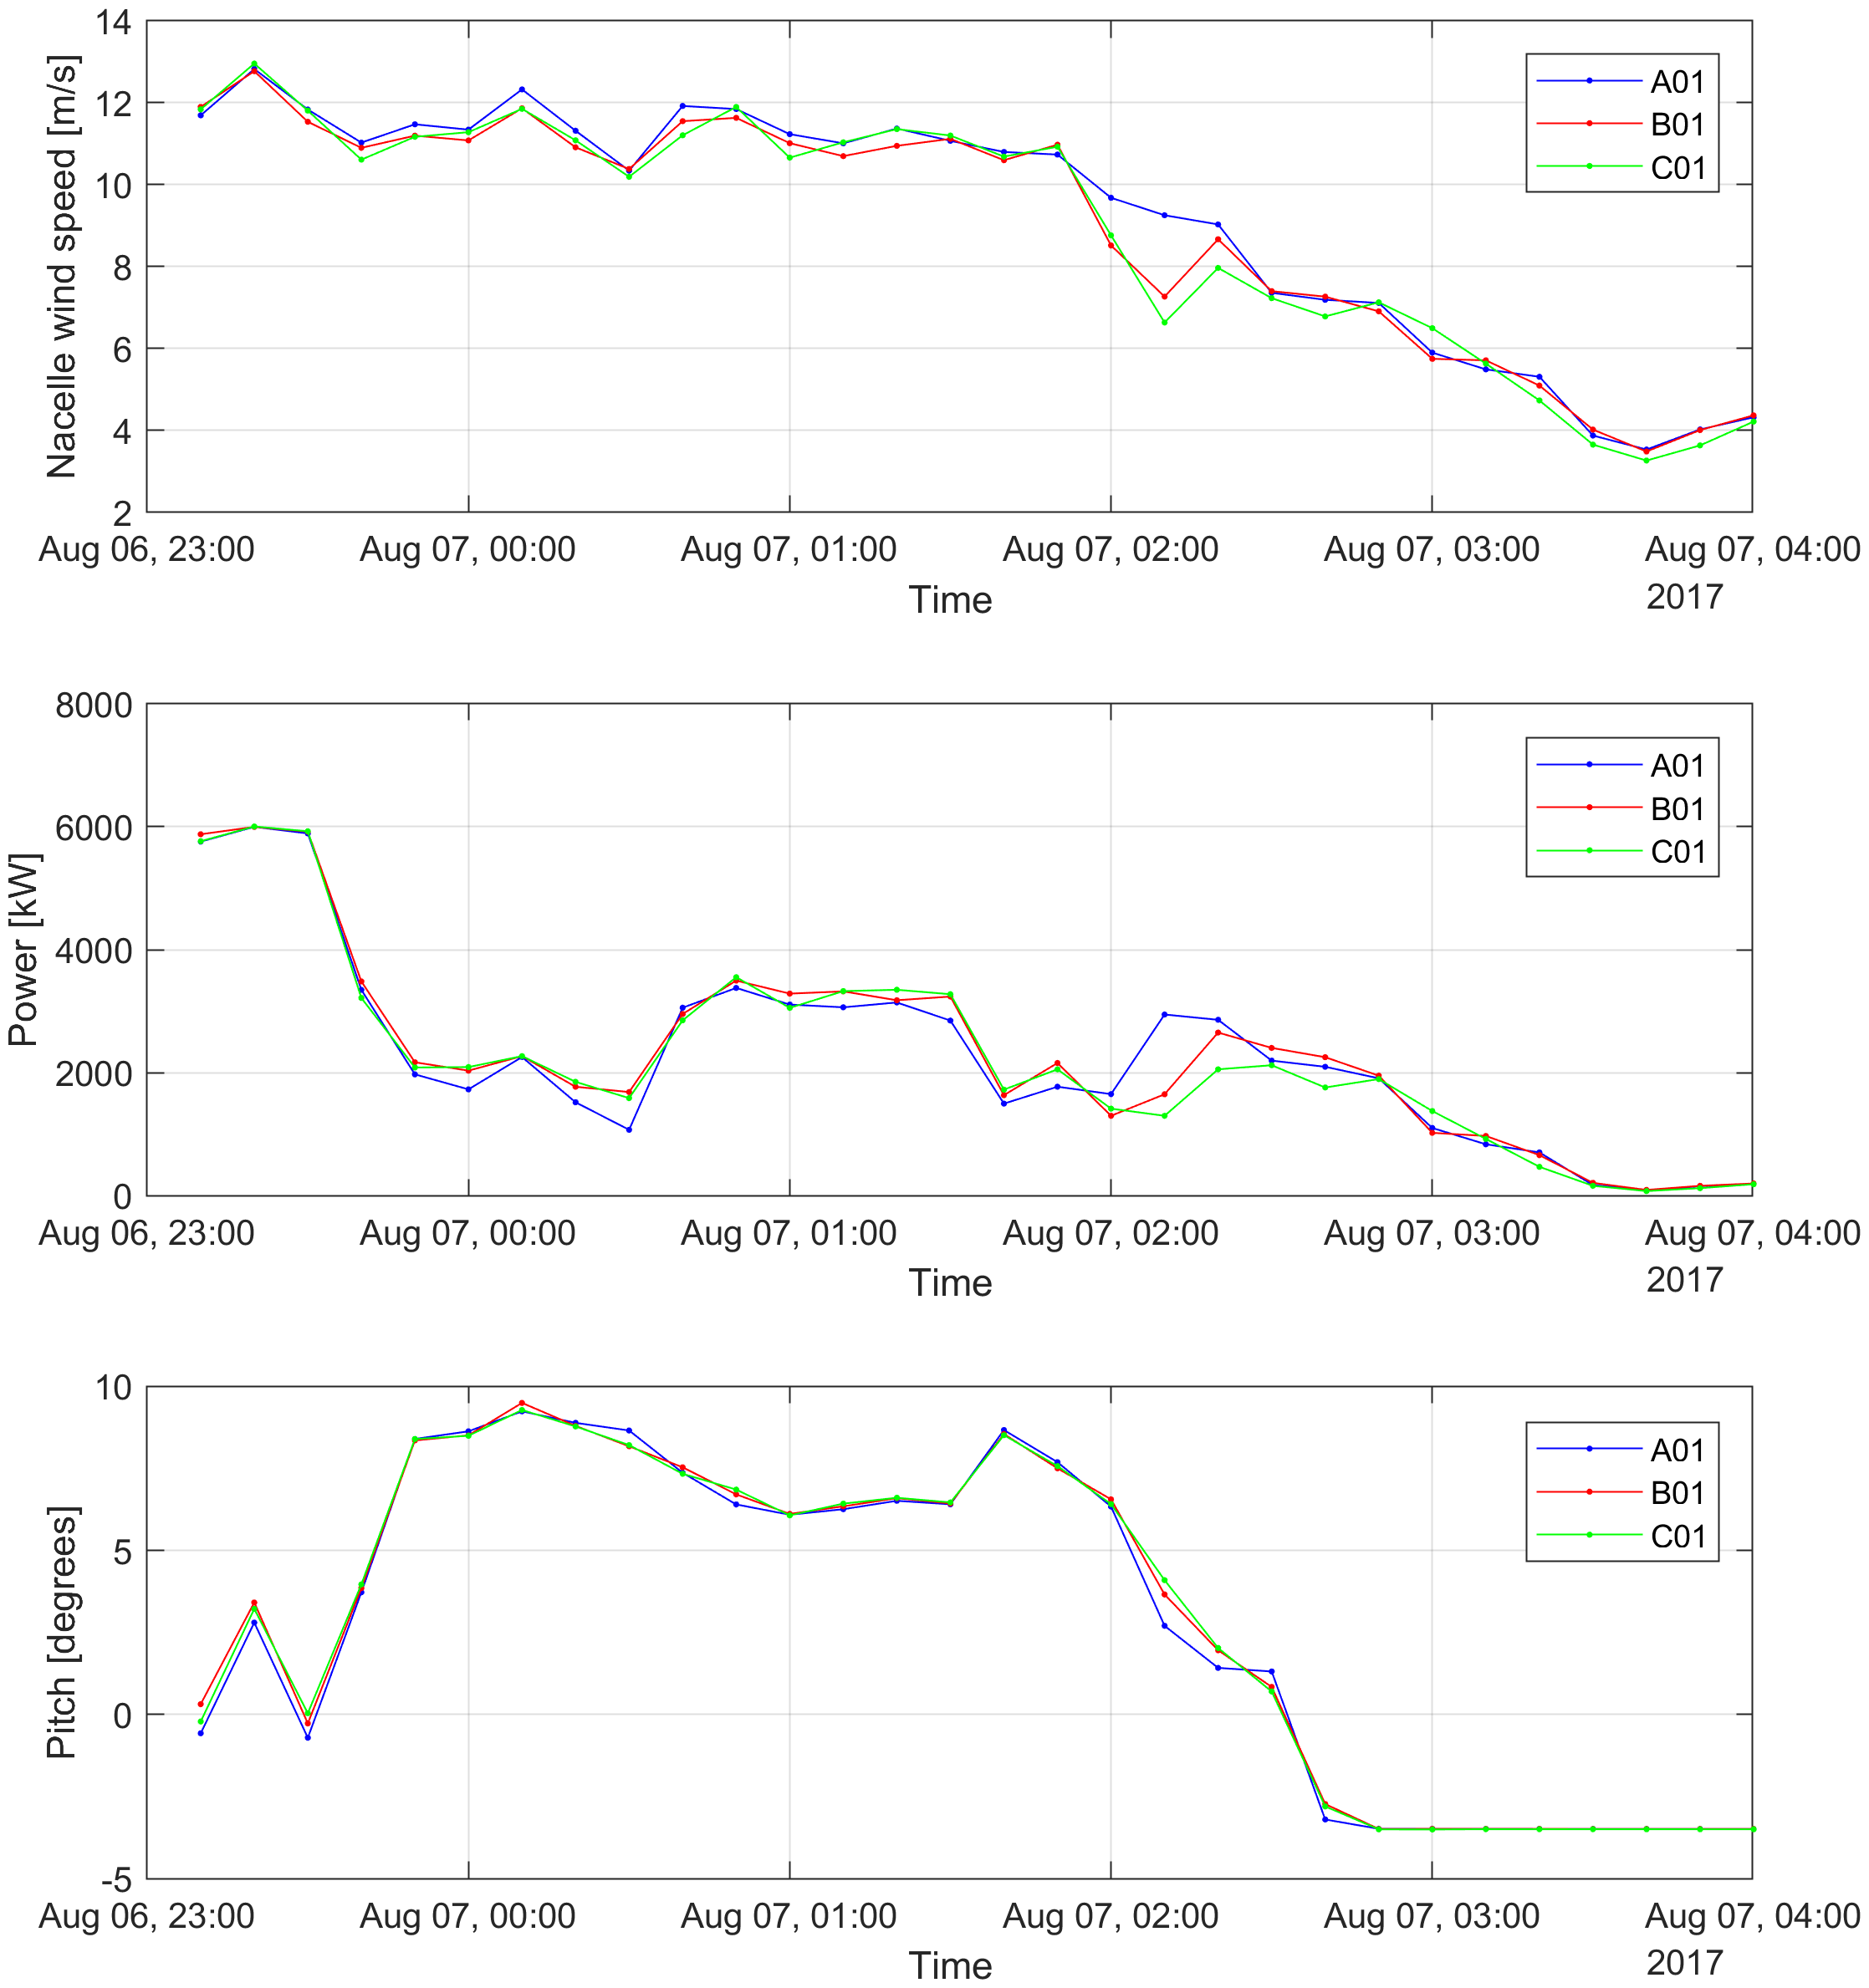
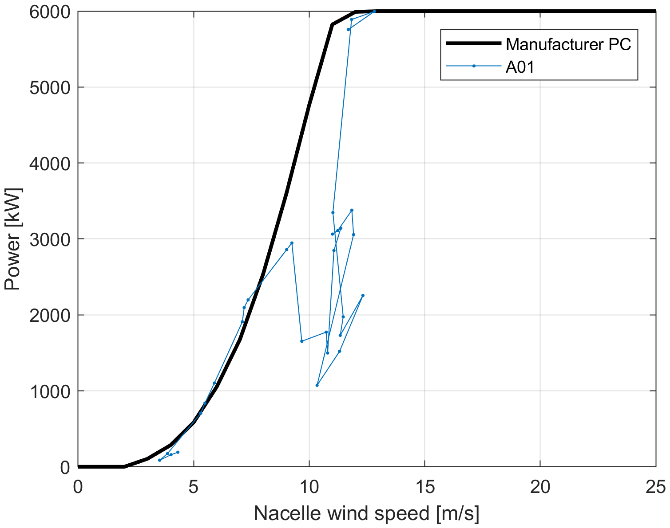
BEACon - SCADA data
Case 3: U0=9,7 m/s

Slide 6
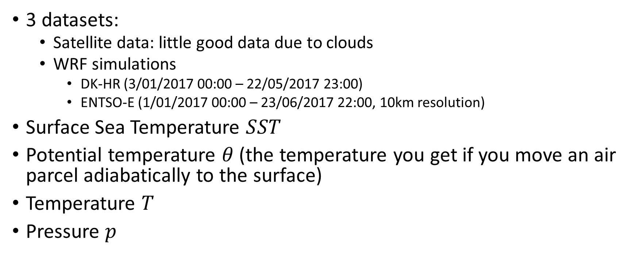
Stability
3 datasets:
Satellite data: little good data due to clouds
WRF simulations
DK-HR (3/01/2017 00:00 – 22/05/2017 23:00)
ENTSO-E (1/01/2017 00:00 – 23/06/2017 22:00, 10km resolution)
Surface Sea Temperature $SST$
Potential temperature $θ$(the temperature you get if you move an air parcel adiabatically to the surface)
Temperature $T$
Pressure $p$

Slide 7
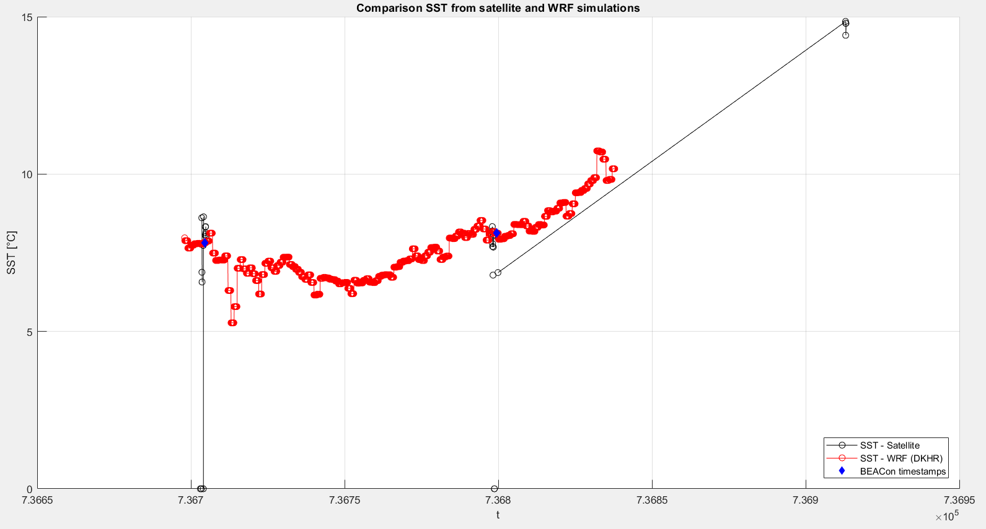
Stability
Well agreement between satellite data and WRF for SST

Slide 8
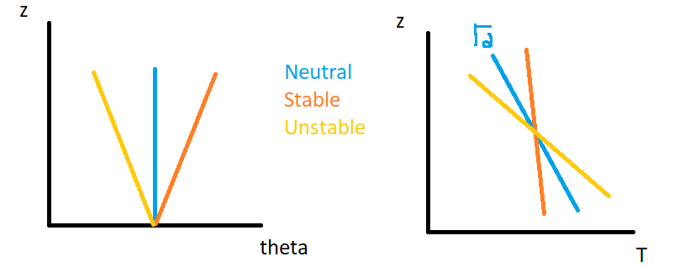
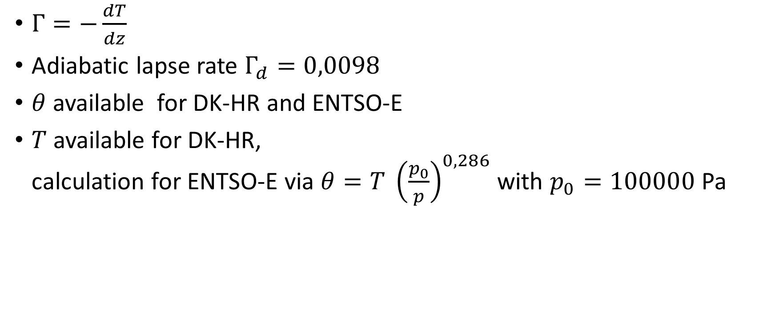
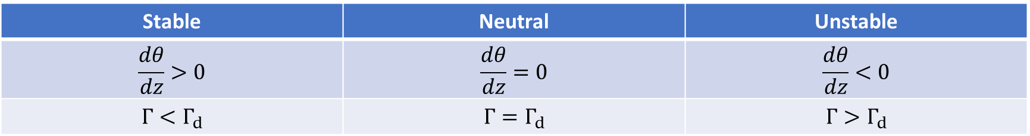
Stability
Stable | Neutral | Unstable
$$\frac{dθ}{dz}>0$$ | $$\frac{dθ}{dz}=0$$ | $$\frac{dθ}{dz}<0$$
$$Γ<Γ_{d}$$ | $$Γ=Γ_{d}$$ | $$Γ>Γ_{d}$$
$Γ=−\frac{dT}{dz}$
Adiabatic lapse rate $Γ_{d}=0,0098$
$θ$ available for DK-HR and ENTSO-E
$T$ available for DK-HR, calculation for ENTSO-E via $θ=T {\left(\frac{p_{0}}{p}\right)}^{0,286}$ with $p_{0}=100000$ Pa

Slide 9
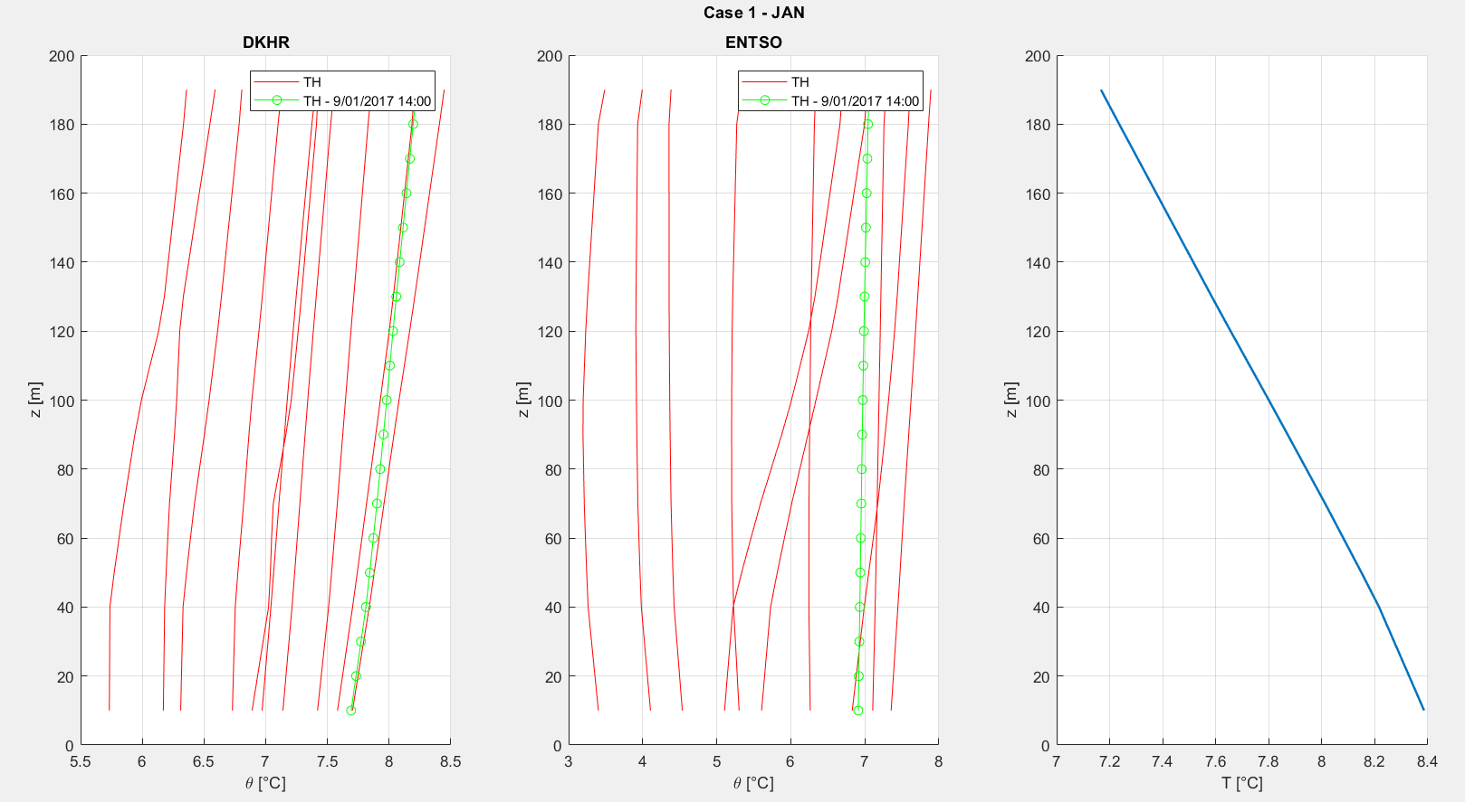
Stability

Slide 10
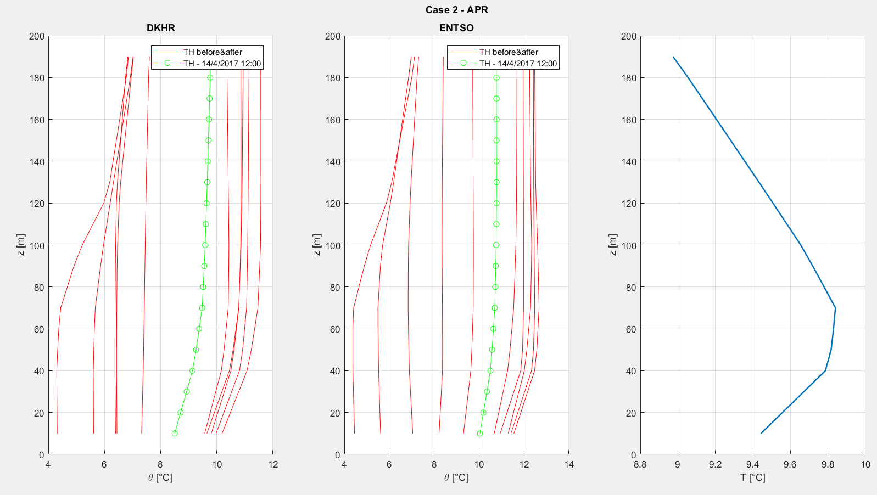
Stability

Slide 11
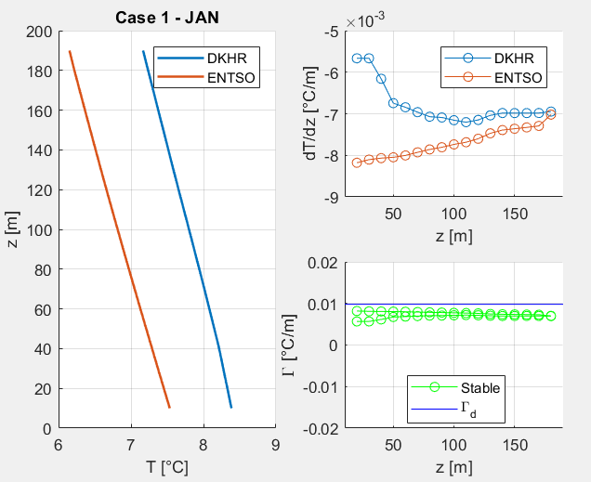
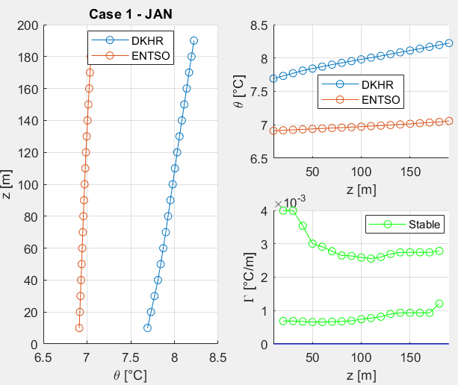
Stability – Case 1 (January)

Slide 12
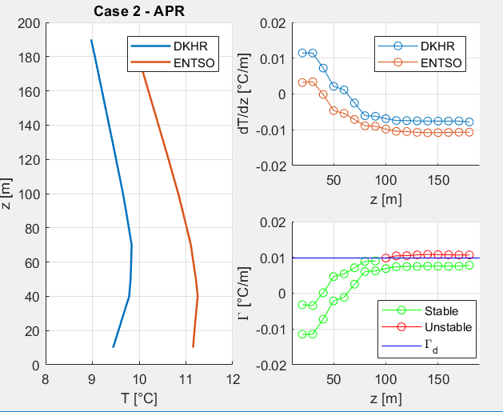
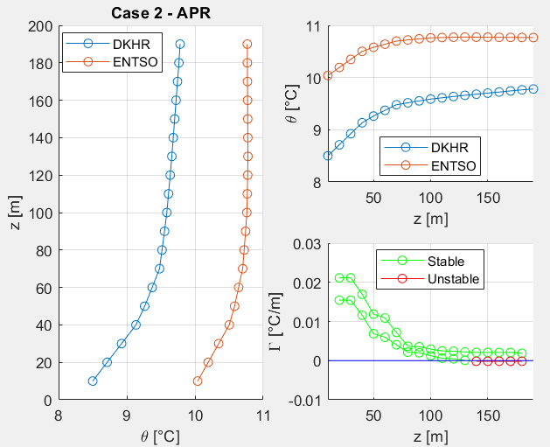
Stability – Case 2 (April)

Slide 13
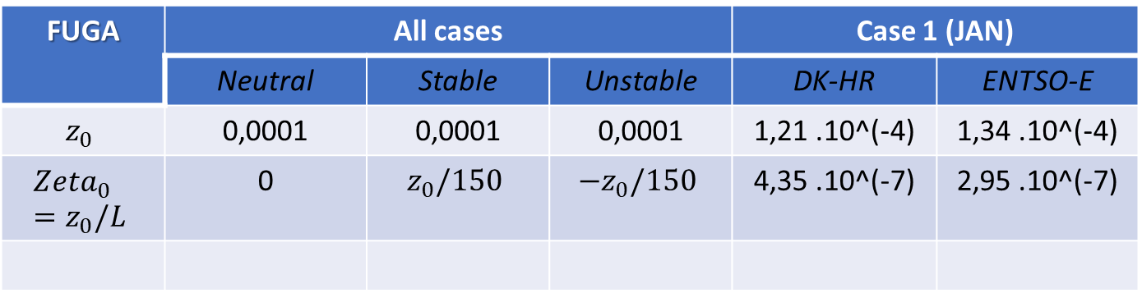
Results
BEACon
LES
Fuga
Case 1 (JAN) via Fuga:
U0=11,97 m/s at 106 m
T at 10 m
T at 100 m
FUGA | All cases |  |  | Case 1 (JAN)
 | Neutral | Stable | Unstable | DK-HR | ENTSO-E
$$z_{0}$$ | 0,0001 | 0,0001 | 0,0001 | 1,21 .10^(-4) | 1,34 .10^(-4)
$$Zeta_{0}=z_{0}/L$$ | 0 | $$z_{0}/150$$ | $${−z}_{0}/150$$ | 4,35 .10^(-7) | 2,95 .10^(-7)

Slide 14
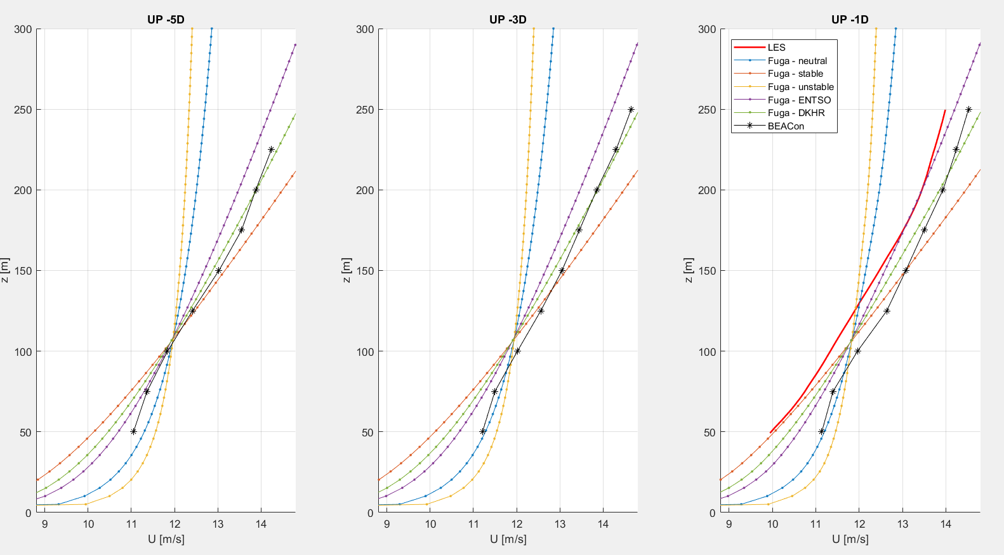
Inflow profiles – Case 1 (January)

Slide 15
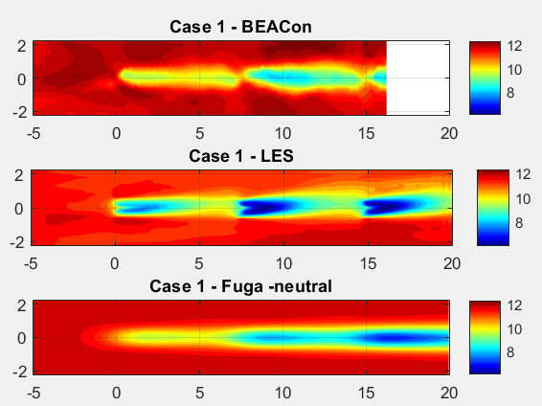
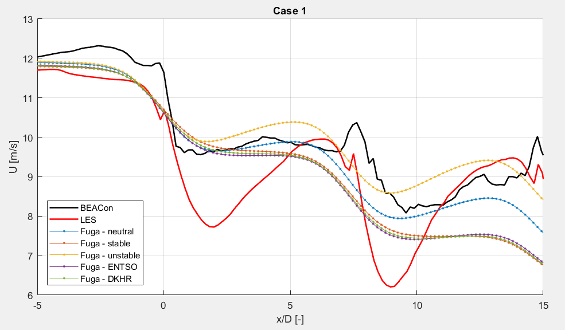
Results – Case 1 (January)

Slide 16
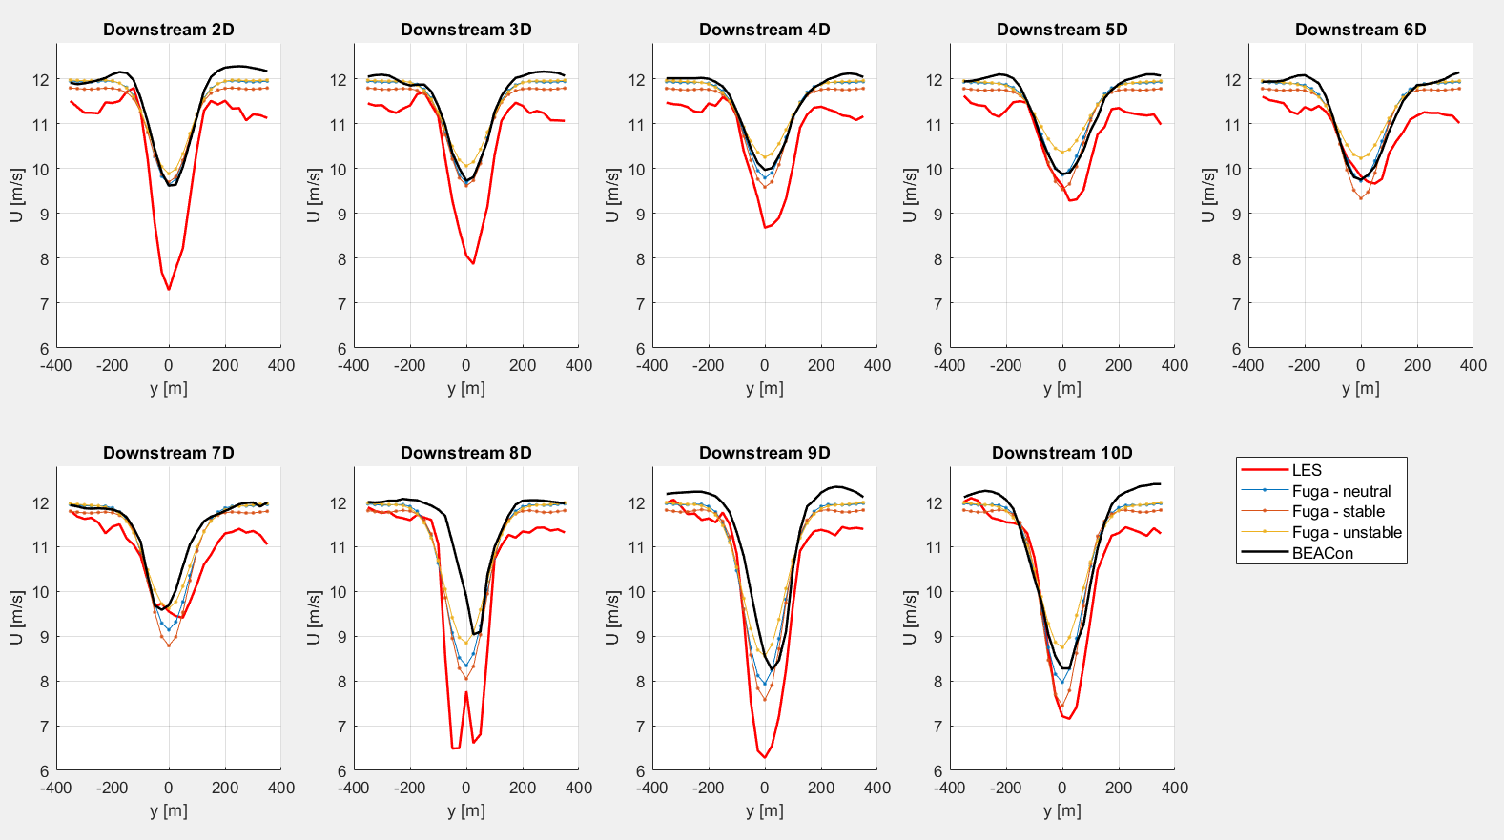

Slide 17
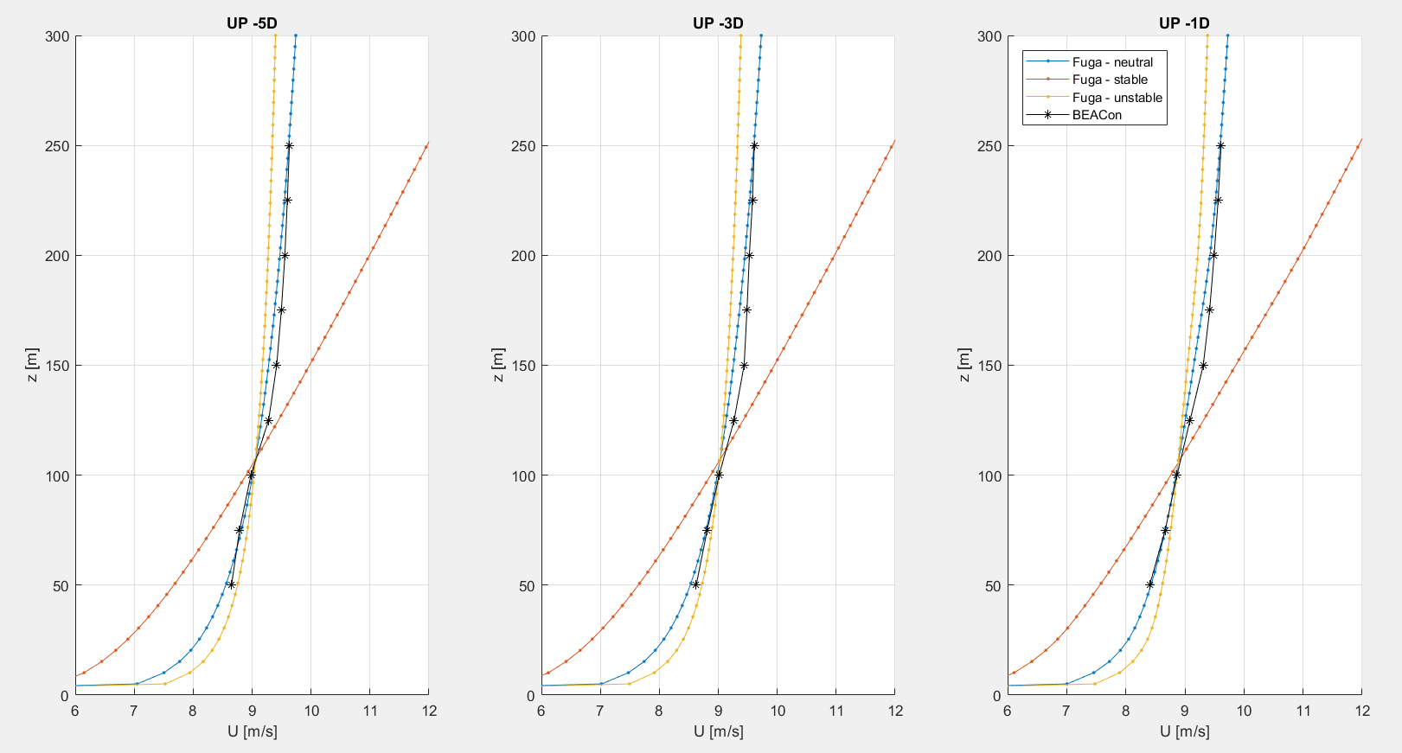
Inflow profiles – Case 2 (April)

Slide 18
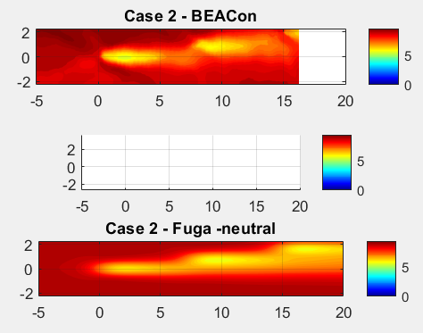
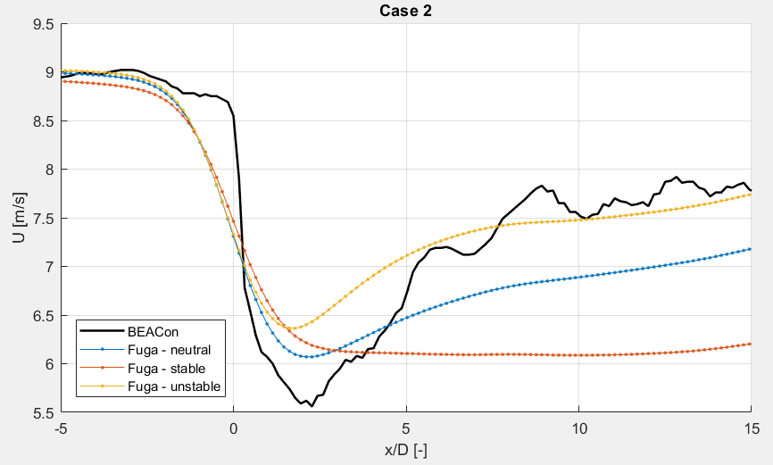
Results – Case 2 (April)

Slide 19
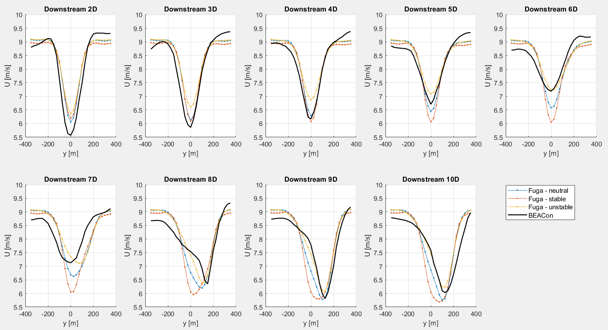

Slide 20
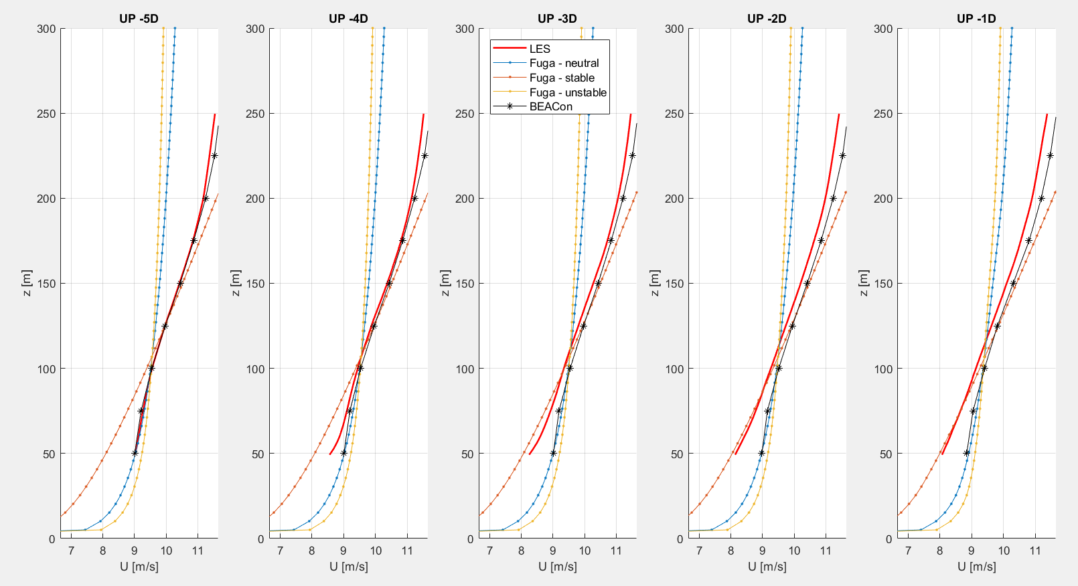
Inflow profiles – Case 3 (August)

Slide 21
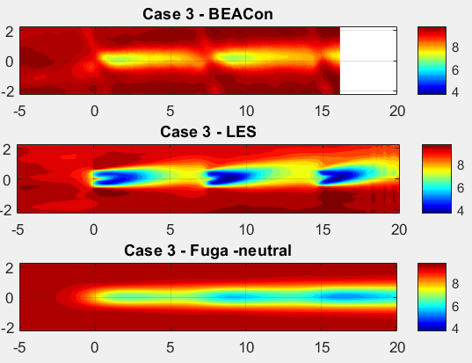
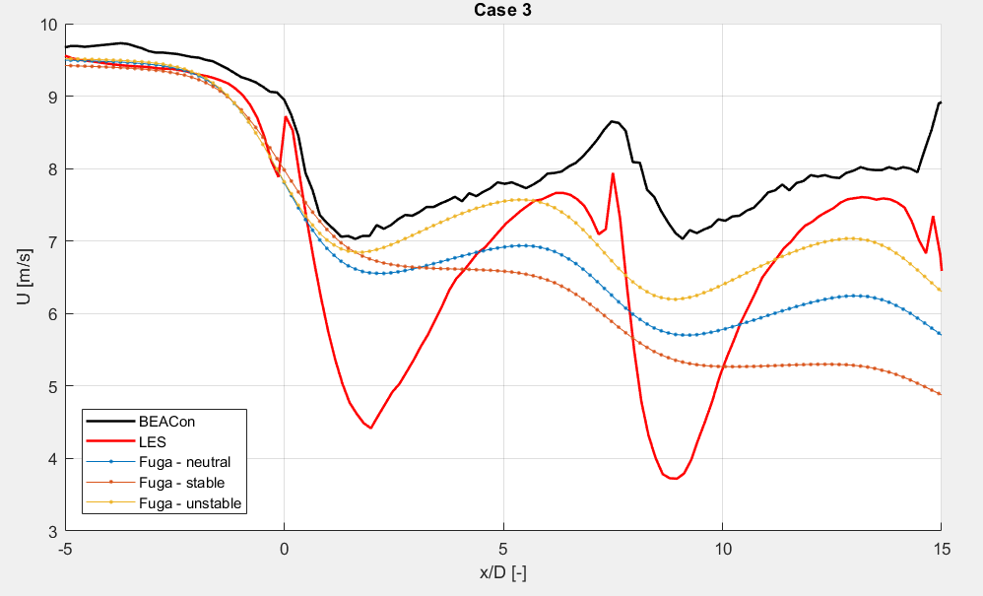
Results – Case 3

Slide 22
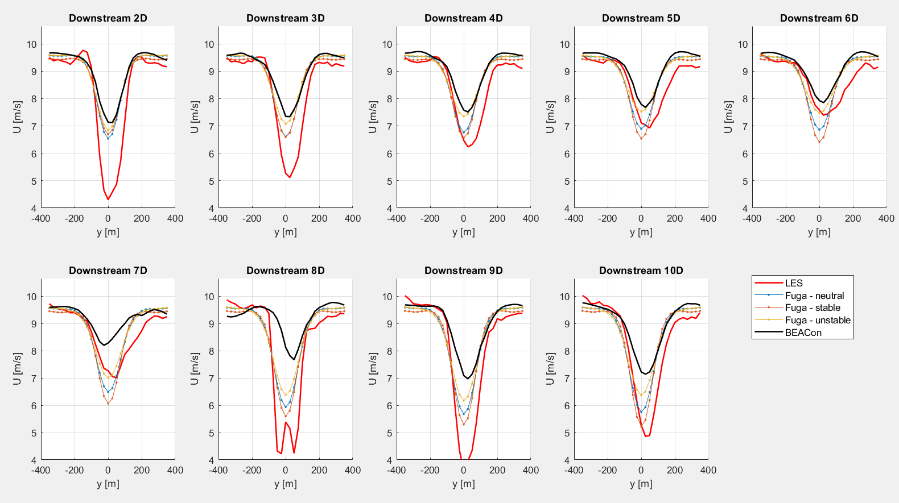

Slide 23
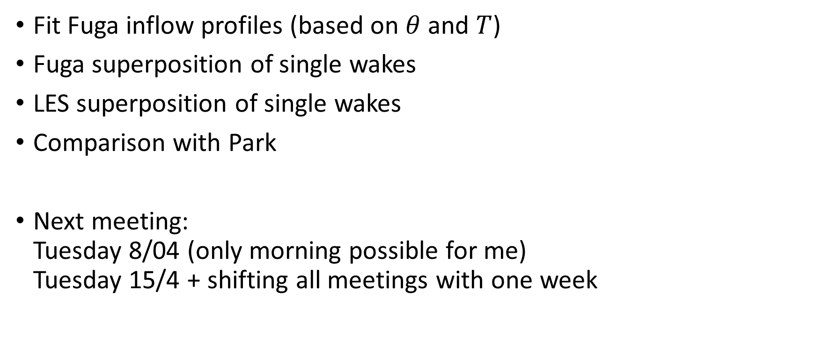
Next steps
Fit Fuga inflow profiles (based on $θ$ and $T$)
Fuga superposition of single wakes
LES superposition of single wakes
Comparison with Park
Next meeting: Tuesday 8/04 (only morning possible for me) Tuesday 15/4 + shifting all meetings with one week

Slide 24
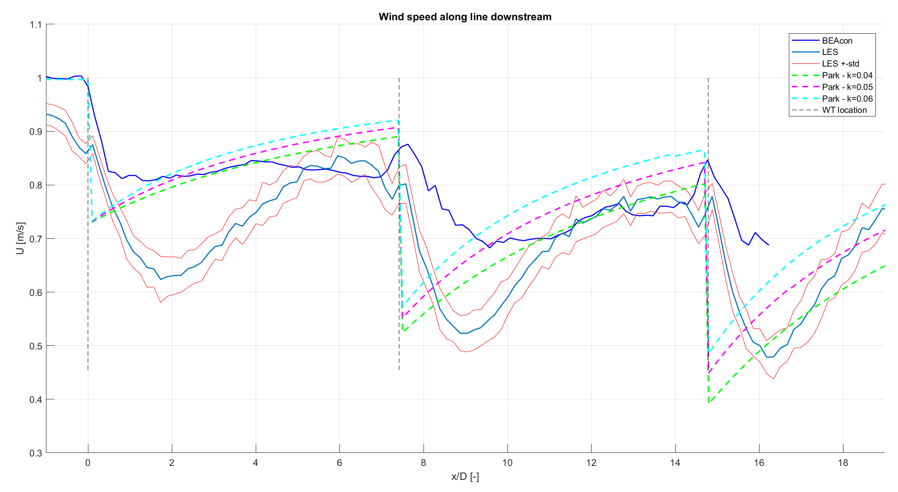
Comparison data & Park (Case 1)
Data at 100m height Park: quadratic superposition, with correction factor and wake reflection

